Slide 1
Model Serving Patterns
Pravin Y Pawar
Extracted from
Three Levels of ML Software

Slide 2
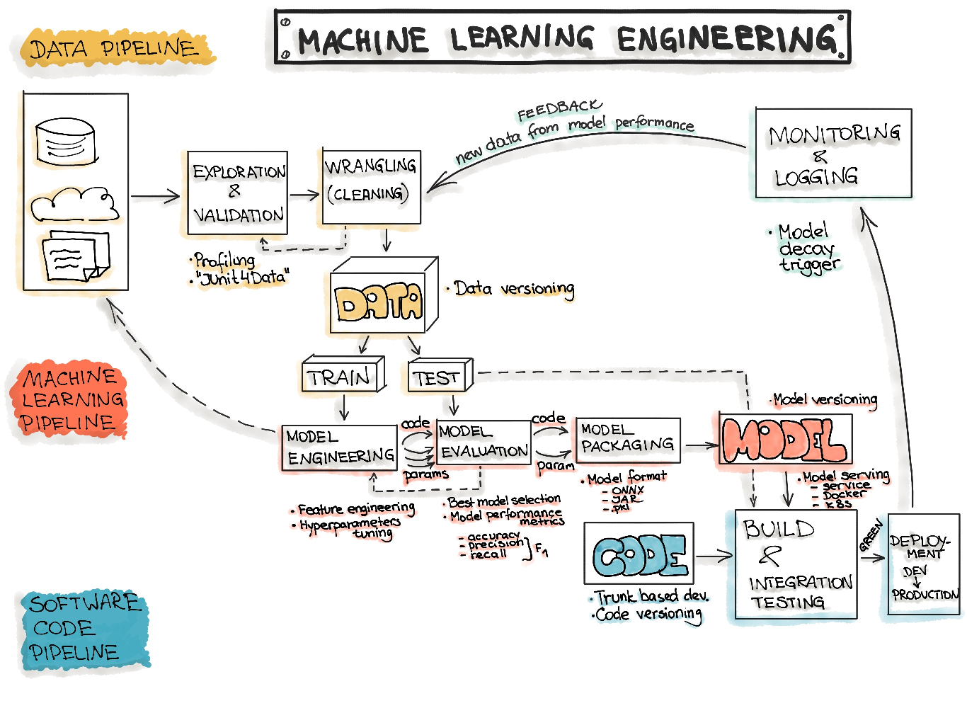
Machine Learning Workflow

Slide 3
Code: Deployment Pipelines
The final stage of delivering an ML project includes the following three steps:
  Model Serving
  Model Performance Monitoring
  Model Performance Logging
Model Serving
  The process of deploying the ML model in a production environment
Model Performance Monitoring
  The process of observing the ML model performance based on live and previously unseen data, such as prediction or recommendation
  interested in ML-specific signals, such as prediction deviation from previous model performance
  signals might be used as triggers for model re-training
Model Performance Logging
  Every inference request results in a log-record.

Slide 4
Model Serving Patterns
Three components should be considered when ML model is served in a production environment
  The inference is the process of getting data to be ingested by a model to compute predictions
  requires a model, an interpreter for the execution, and input data
Deploying an ML system to a production environment includes two aspects,
  First deploying the pipeline for automated retraining and ML model deployment
  Second, providing the API for prediction on unseen data
Model serving is a way to integrate the ML model in a software system
Five patterns to put the ML model in production:
  Model-as-Service
  Model-as-Dependency
  Precompute
  Model-on-Demand
  and Hybrid-Serving

Slide 5
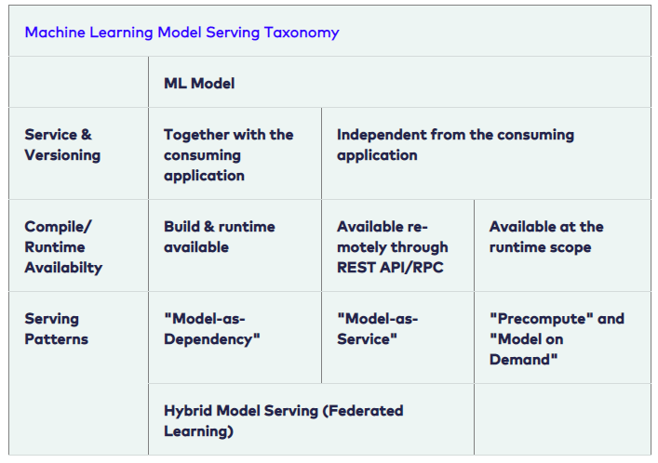
Model Serving Patterns(2)
Machine Learning Model Serving Taxonomy

Slide 6
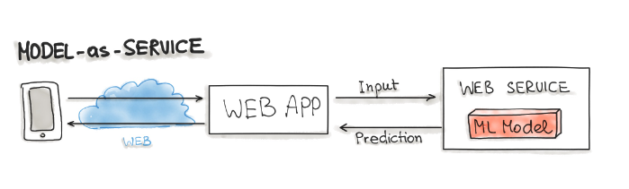
Model-as-Service
A common pattern for wrapping an ML model as an independent service
  can wrap the ML model and the interpreter within a dedicated web service
  applications can request through a REST API or consume as a gRPC service
Used for various ML workflows
  Forecast
  Web Service
  Online Learning

Slide 7
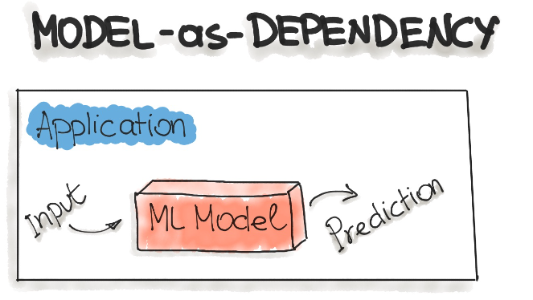
Model-as-Dependency
Probably the most straightforward way to package an ML model
  mostly used for implementing the Forecast pattern.
A packaged ML model is considered as a dependency within the software application
  For example, the application consumes the ML model like a conventional jar dependency by invoking the prediction method and passing the values
  The return value of such method execution is some prediction that is performed by the previously trained ML model

Slide 8
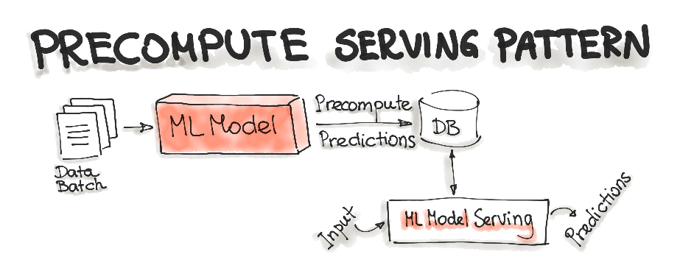
Precompute Serving Pattern
Tightly related to the Forecast ML workflow
Use an already trained ML model and precompute the predictions for the incoming batch of data
  Resulting predictions are persisted in the database
  For any input request, query the database to get the prediction result

Slide 9
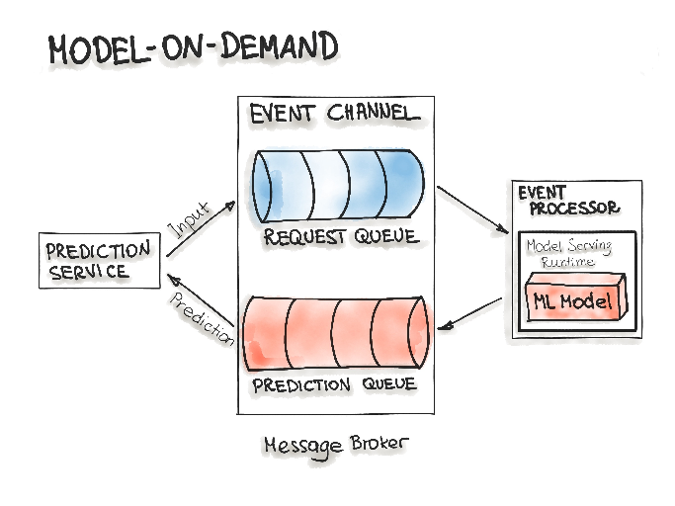
Model-on-Demand
Treats the ML model as a dependency that is available at runtime
  contrary to the Model-as-Dependency pattern, has its own release cycle and is published independently
Message-broker architecture is typically used for such on-demand model serving
  contains two main types of architecture components:
    a broker component
    an event processor component
  Broker component is the central part that contains the event channels that are utilised within the event flow
  The event channels, which are enclosed in the broker component, are message queues
  Message broker allows one process to write prediction-requests in an input queue
  Event processor contains the model serving runtime and the ML model
    connects to the broker, reads these requests in batch from the queue and sends them to the model to make the predictions
The model serving process runs the prediction generation on the input data
  writes the resulted predictions to the output queue
  queued prediction results are pushed to the prediction service that initiated the prediction request

Slide 10
Hybrid-Serving (Federated Learning)
Unique in the way it does, there is not only one model that predicts the outcome, but there are also lots of it
  Exactly spoken there are as many models as users exist, in addition to the one that’s held on a server
Start with the unique model, the one on the server
  Model on the server-side is trained only once with the real-world data
  sets the initial model for each user
  a relatively general trained model so it fits for the majority of users
On the other side, there are the user-side models - really unique models
  possible for the devices to train their own models due to hardware enhancements
  devices will train their own highly specialized model for their own user
  Once in a while, the devices send their already trained model data (not the personal data) to the server
Then the server model will be adjusted
  the actual trends of the whole user community will be covered by the model
  this updated server model is set to be the new initial model that all devices are using

Slide 11
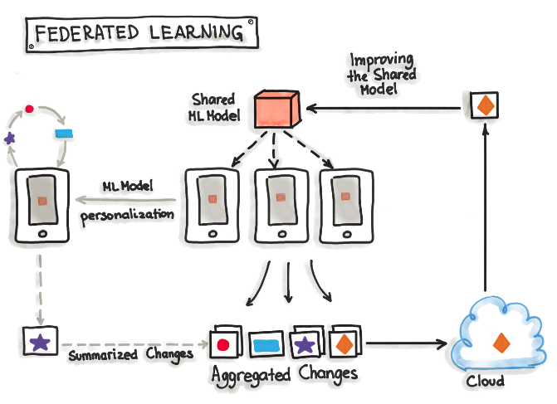
Hybrid-Serving (Federated Learning) 2
Not having any downsides for the users, while the server model gets updated, this happens only when the device is idle, connected to WiFi and charging
  testing is done on the devices, therefore the newly adopted model from the server is sent to the devices and tested for functionality
Big benefit
  data used for training and testing, which is highly personal, never leaves the devices while still capturing all data that is available
  possible to train highly accurate models while not having to store tons of (probably personal) data in the cloud
Constraints
  mobile devices are less powerful
  the training data is distributed across millions of devices and these are not always available for training
  Exactly for this TensorFlow Federated (TFF) has been created - lightweight form of TensorFlow

Slide 12
Deployment Strategies
Common ways for wrapping trained models as deployable services, namely deploying ML models as
  Docker Containers to Cloud Instances
  Serverless Functions

Slide 13
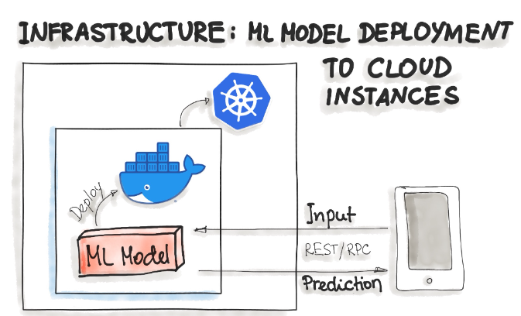
Deploying ML Models as Docker Containers
No standard, open solution to ML model deployment!
Containerization becomes the de-facto standard for delivery
  as ML model inference being considered stateless, lightweight, and idempotent
  means deploy a container that wraps an ML model inference code
Docker is considered to be de-facto standard containerization technology
  for on-premise, cloud, or hybrid deployments
One ubiquitous way is to package the whole ML tech stack (dependencies) and the code for ML model prediction into a Docker container
  Then Kubernetes or an alternative (e.g. AWS Fargate) does the orchestration
  The ML model functionality, such as prediction, is then available through a REST API (e.g. implemented as Flask application)

Slide 14
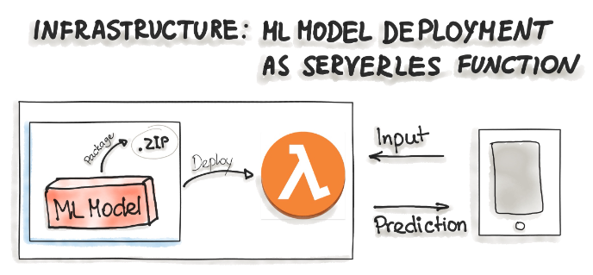
Deploying ML Models as Serverless Functions
Various cloud vendors already provide machine-learning platforms - can deploy model with their services
  Amazon AWS Sagemaker, Google Cloud AI Platform, Azure Machine Learning Studio, and IBM Watson Machine Learning
  Commercial cloud services also provide containerization of ML models such as AWS Lambda and Google App Engine servlet host
In order to deploy an ML model as a serverless function,
  the application code and dependencies are packaged into .zip files, with a single entry point function
  could be managed by major cloud providers such as Azure Functions, AWS Lambda, or Google Cloud Functions
  However, attention should be paid to possible constraints of the deployed artifacts such as the size of the artifacts

Slide 15
Thank You!
In our next session:

